Slide 1
NEXTHIKES IT SOLUTIONS
PROJECT-3 :- Exploratory Data Analysis (EDA) for Real Estate Pricing.
BY:- NAMAN SHARMA

Slide 2
What is Exploratory Data Analysis? Exploratory Data Analysis (EDA) is an important first step in data science projects. It involves looking at and visualizing data to understand its main features, find patterns, and discover how different parts of the data are connected. EDA helps to spot any unusual data or outliers and is usually done before starting more detailed statistical analysis or building models.

Slide 3
PROJECT OBJECTIVE
1. The task is to conduct a comprehensive analysis to identify and understand the myriad variables that significantly influence house prices.
2. Implementing advanced data analytics techniques and visualization tools, goal is to uncover patterns, correlations, and trends within the dataset, enabling the company to make informed decisions and strategically position properties for better business opportunities.

Slide 4

PROJECT WORKFLOW
1. Loading the Data.
2. Cleaning the Data.
3. Univariate Analysis.
4. Bivariate Analysis.
5. Multivariate Analysis.
6. Feature Engineering.
7. Feature Engineering and Size Impact.
8. Customer Preferences and Amenities.

Slide 5
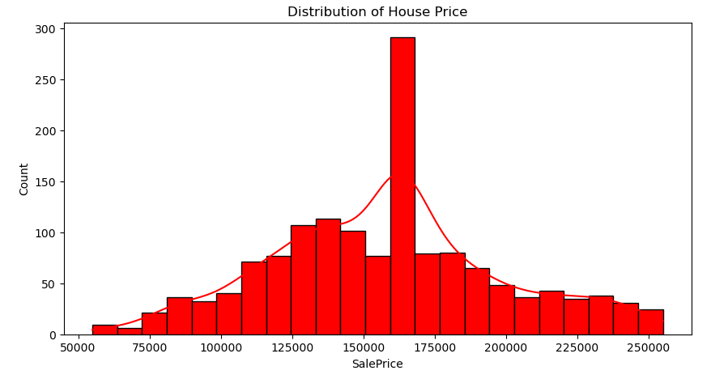
UNIVARIATE ANALYSIS
1. By looking at the graph we can say that data is normally distributed i.e. mean = median = mode.
2. Data is spreaded between 55,000 to 2,50,000.
3. The graph also shows that between 1,25,000 to 1,75,000 the highest number of houses were sold.
4. We can also observe that the highest count is at 170000.

Slide 6
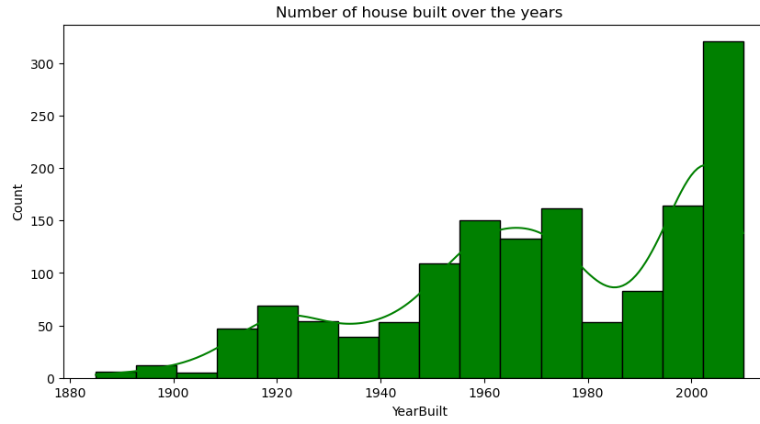
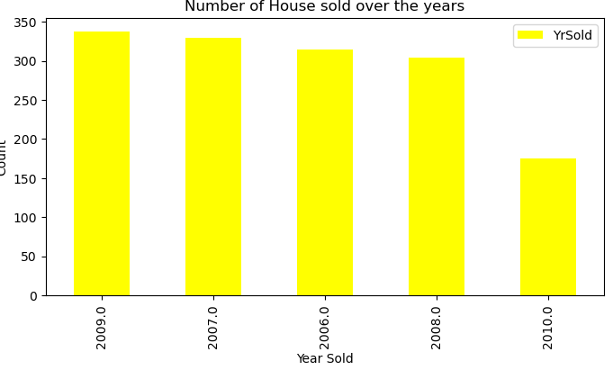
1.I can see it's a negatively skewed graph the tail of the dataset is on the left side.
2. mean < median < mode.
3. Major data lies in year 2000 and above.
4. We have high number of houses built in year 2000 and above as compared to others.
5. We can also observe that with time(as the year passes)the count is also increasing.
6 Also we can see there was a fluctuation in count in year 1980 due to some unavoidable circumstances but again it took a rapid growth year 2000.
In year 2009 maximum number of houses were sold approx (340).
2. In year 2010 minimum number of houses were sold approx (180).

Slide 7
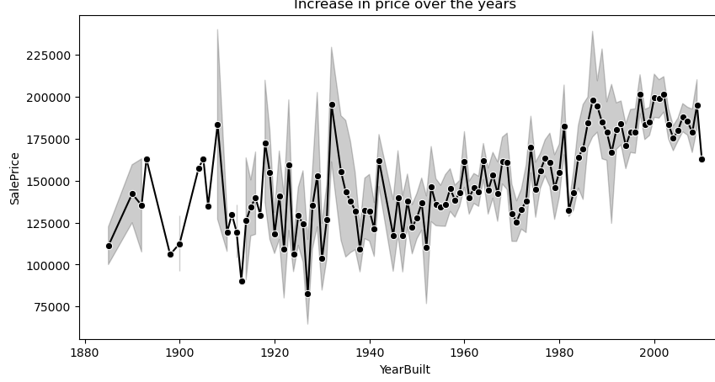
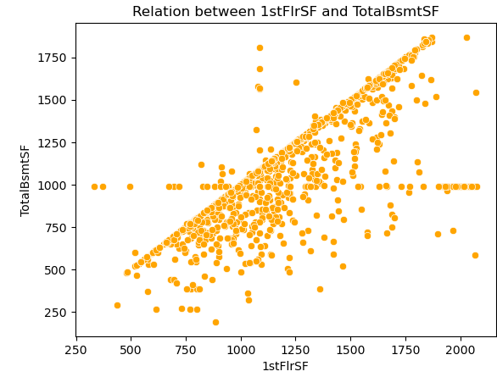
BIVARIATE ANALYSIS
The line plot gives the following insights :-
1. As the year passes the house price increases.
2. The lowest sell price can be seen between year 1910 to 1930.
3. The highest sell price can be seen in year 2000 as compared to others.
The scatter plots gives the insights below :-
From the scatter plot graph we can say that there is a strong positive correlation between "1stFlrSF" and "TotalBsmtSF" as the correlation shows around 79%.

Slide 8
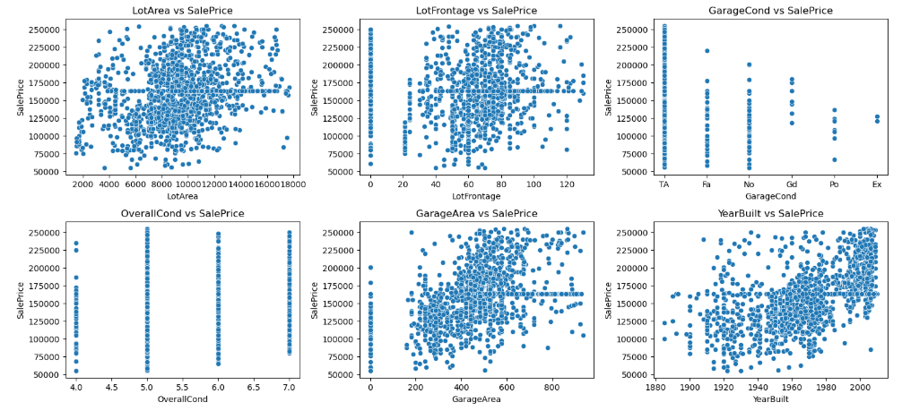
The above scatter plot shows the correlation between :- 1. The Correlation between Lot Area and Sale Price is 0.2930 i.e. it gives weak positive correlation. 2. The Correlation between Lot Frontage and Sale Price is 0.0469 i.e. it gives weak positive correlation. 3. The Correlation between OverallCon and Sale Price is -0.0859 i.e. it gives strong negative correlation. 4. The Correlation between Garage Cond and Sale Price is 0.4740 i.e. it gives weak positive correlation. 5. The correlation between Year Built and Sale Price is 0.5360 i.e. it gives medium positive correlation.

Slide 9
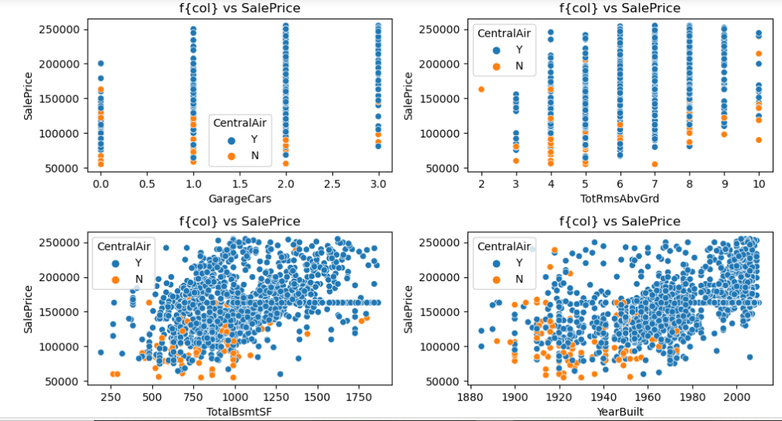
Multivariate Analysis
The Scatter plot shows the correlation between Garage Cars,
TotRmsAbvGrd,
TotalBsmt,
Year Built
v/s
SalePrice.

Slide 10
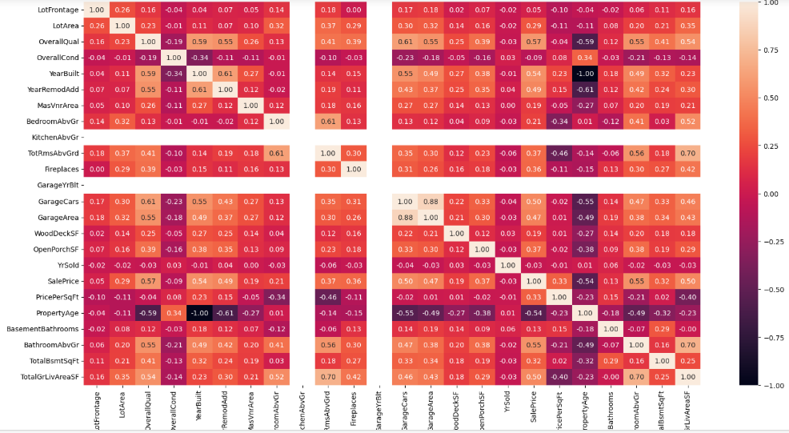
1. It tells the relationship between each columns and how they are related to each other. 2. We can see a color bar on the right side which tells whether the relationship is positive or negative. 3. We can see that the boxes with black color have the negative correlation between them example :- 1. "YearBuilt" and "Property Age" 2."Property Age" and "YearRemodAdd" and many more. 4. We can see that the boxes with light cream color have the positive correlation between them example :- 1. "GarageCars and GarageArea" 2."TotRmsAbvGr" and "TotalGrLivAreaSF" and many more.

Slide 11
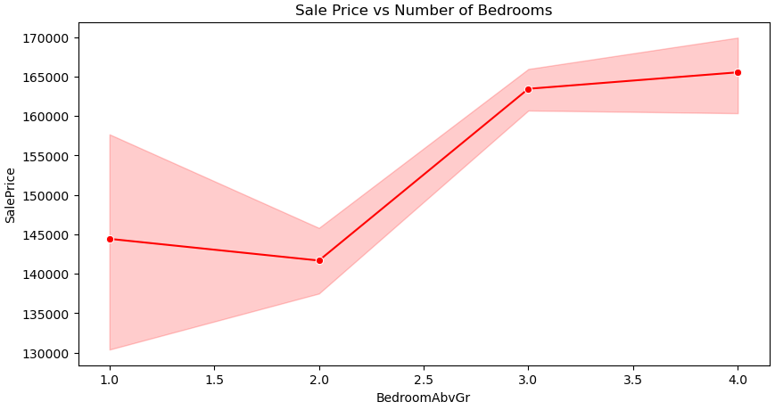
Analyzing the impact of features and size on House Price.
The above graph shows the following insights :-
1. House having 1 and 2 bedrooms lies in range 140000 and 145000.
2. House having 3 and 4 bedrooms lies in range 165000 and 170000.

Slide 12
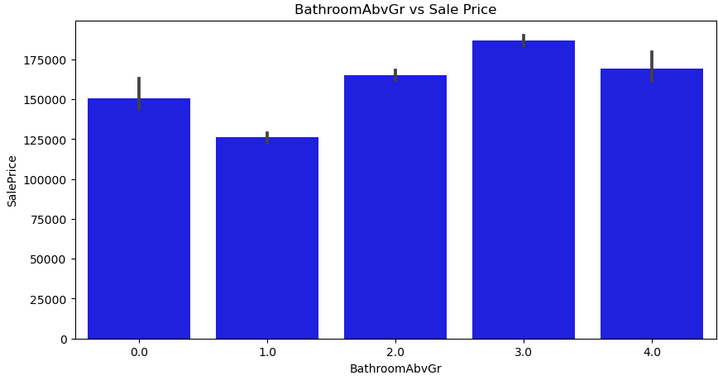
Visualize Sale price vs BathroomAbvGr.
The above graph gives the following insights :-
1. The house having 3 bathrooms has the maximum selling price of around 175000.
2. The house having 1 bathroom has the least selling price of around 125000.

Slide 13
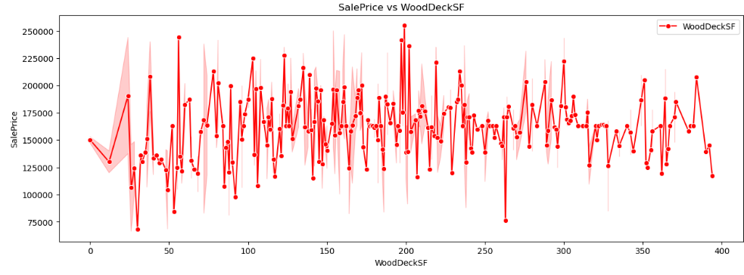
Customer Preferences and Amenities
Visualizing the impact of WoodDeckSF on House Price.
The above line graph shows the following insights :-
1. The house having "WoodDeckSF" between 180 to 210 has the maximum sale price.
2. The house having "WoodDeckSF" of 30 and 270 has the least sale price.
3. Majority of the data lies between 140 to 220 "WoodDeckSF“.

Slide 14
LEARNING OUTCOMES :-
• Gain practical experience in dataset cleaning and wrangling.
• Develop an understanding of exploratory data analysis techniques. Such as Data Cleaning, Handling Missing Values, Handeling Outliers.
Gain the practical knowledge on how to use machine learning algorithm .
• Prepare datasets for advanced modeling and business use cases.

Slide 15
References :-
https://www.geeksforgeeks.org/what-is-exploratory-data-analysis/ https://www.geeksforgeeks.org/what-is-feature-engineering/ https://builtin.com/articles/feature-engineering

Slide 16
THANK YOU

